Slide 1
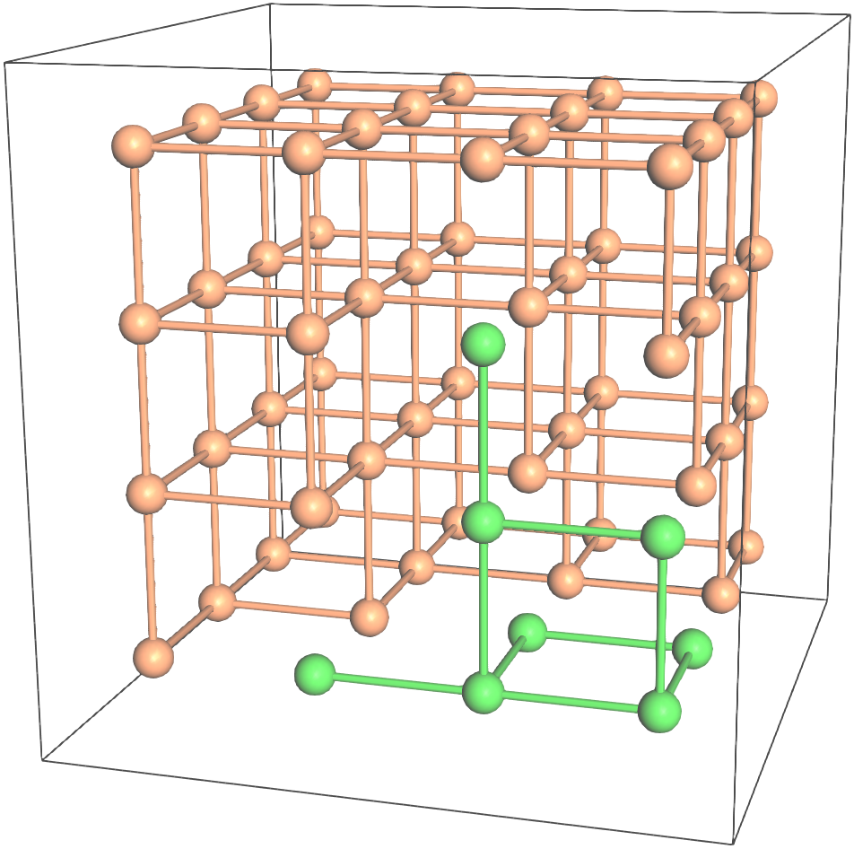
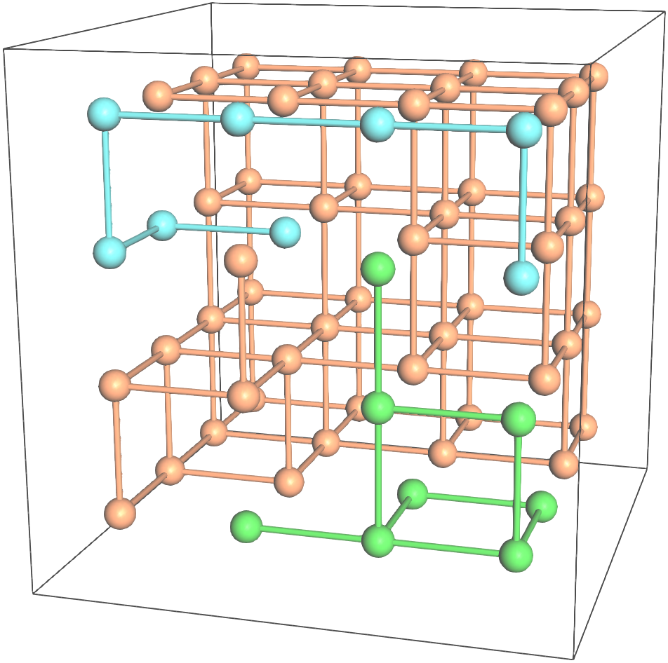
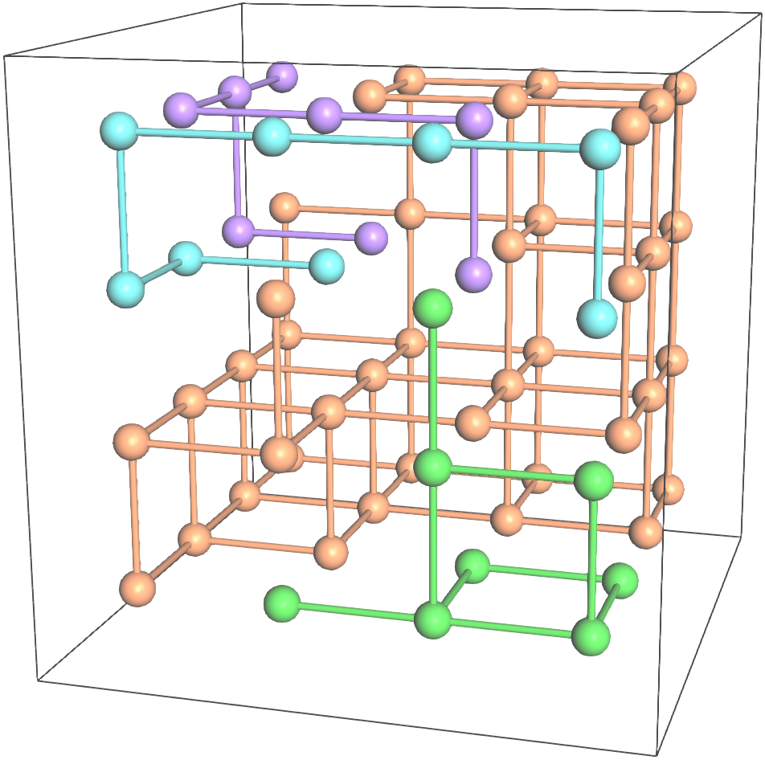
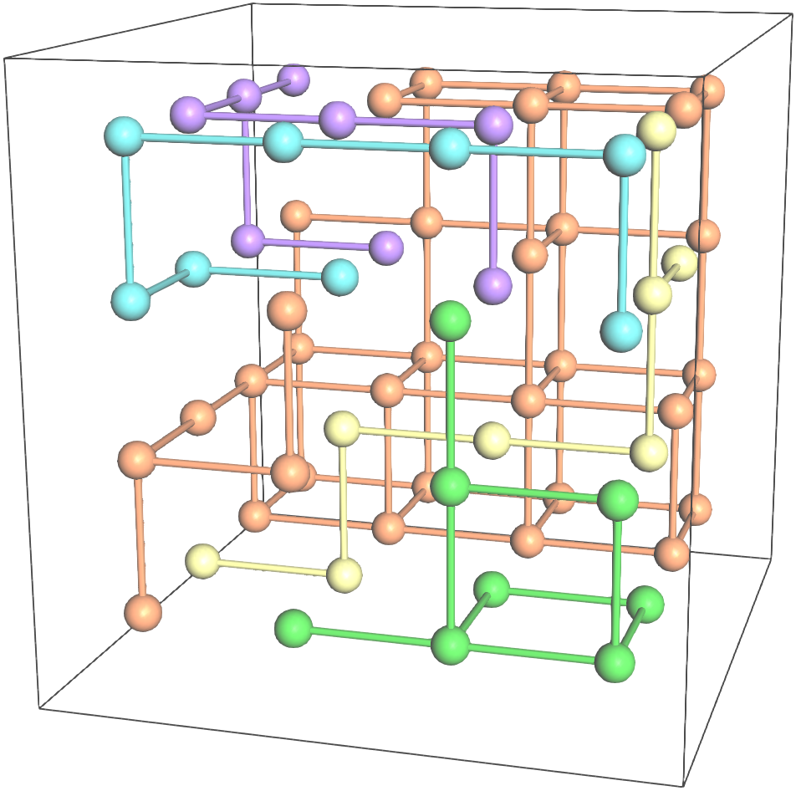
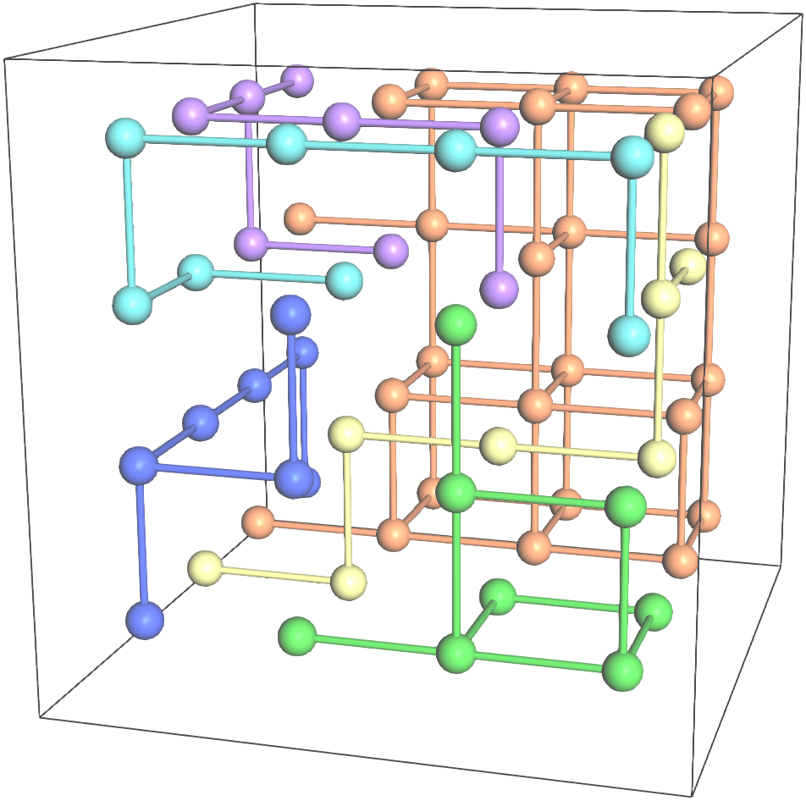
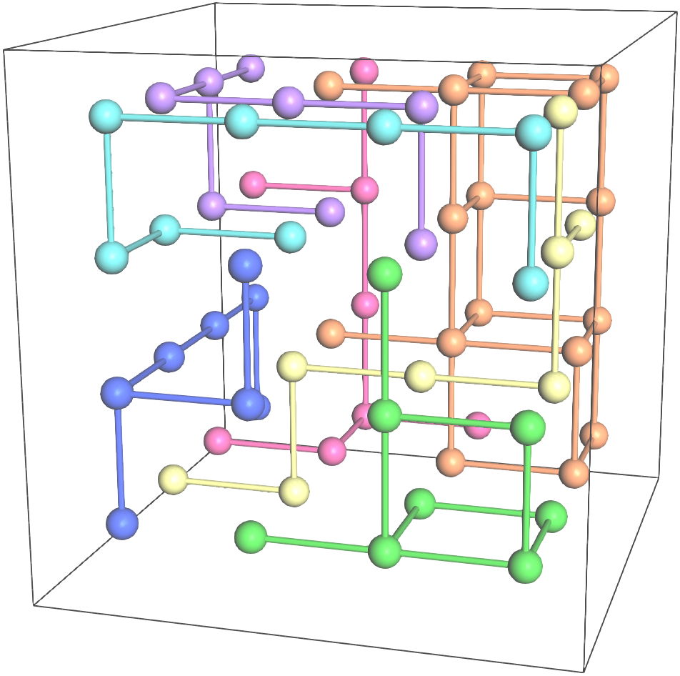
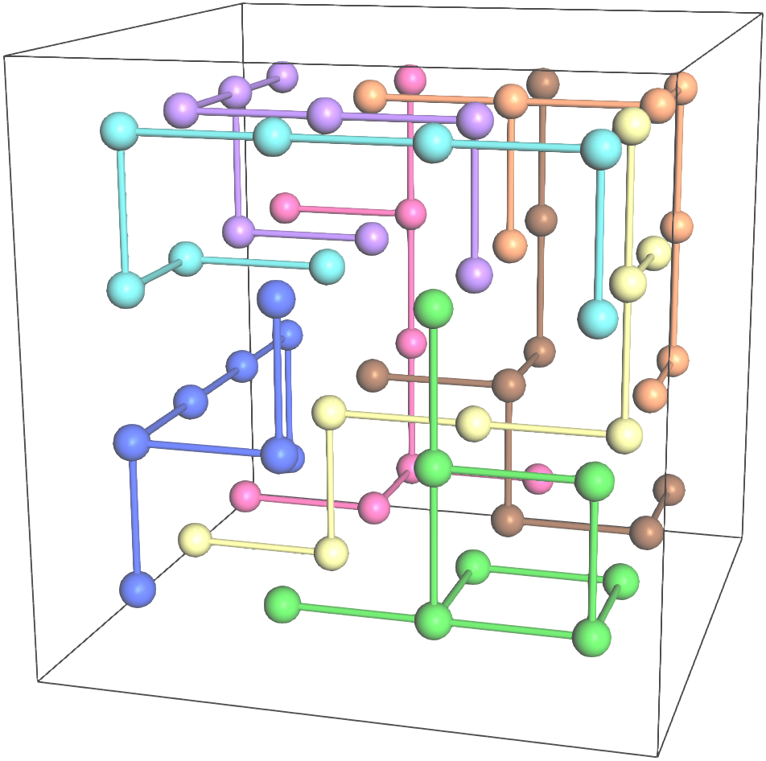
+y
+z
+x
1
1
1
1
1
1
1
G(+x, A_{i})
2
2
3
2
3
2
3
2
3
2
3
2
3
4
4
5
4
5
4
5
4
5
6
6
7
6
8
7
G(+y, A_{i})
2
1
2
1
3
2
1
3
2
1
3
2
1
3
2
1
3
2
1
3
4
4
5
4
5
4
5
4
5
6
6
7
6
8
7
G(+z, A_{i})
2
1
2
1
3
2
1
3
2
1
3
2
1
3
2
1
3
2
1
3
4
4
5
4
5
4
5
4
5
6
6
7
6
8
7
(a)
(b)
(c)
(d)
(e)
(f)
(g)

Slide 2
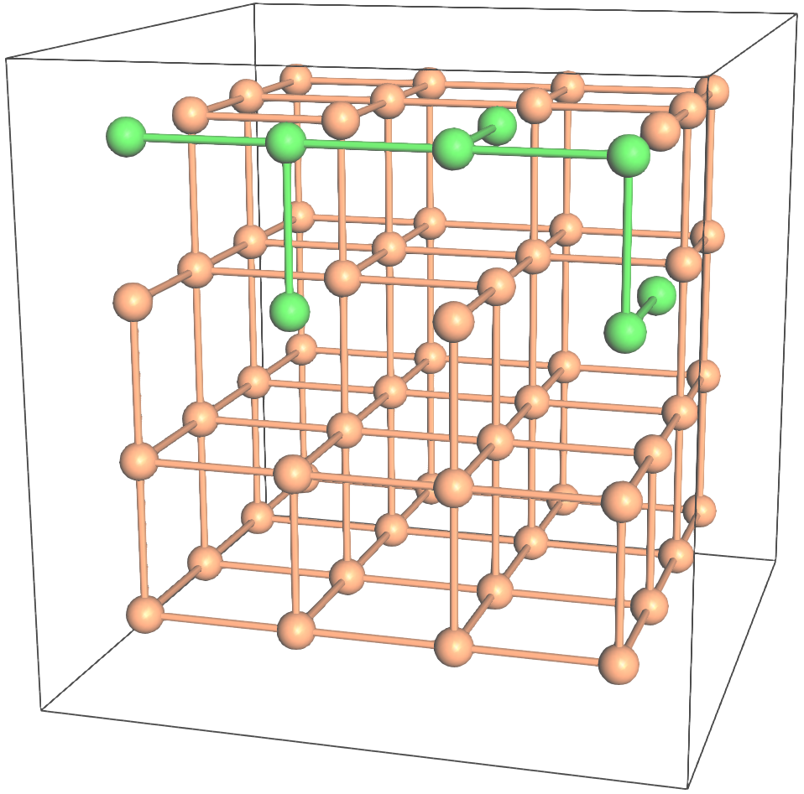
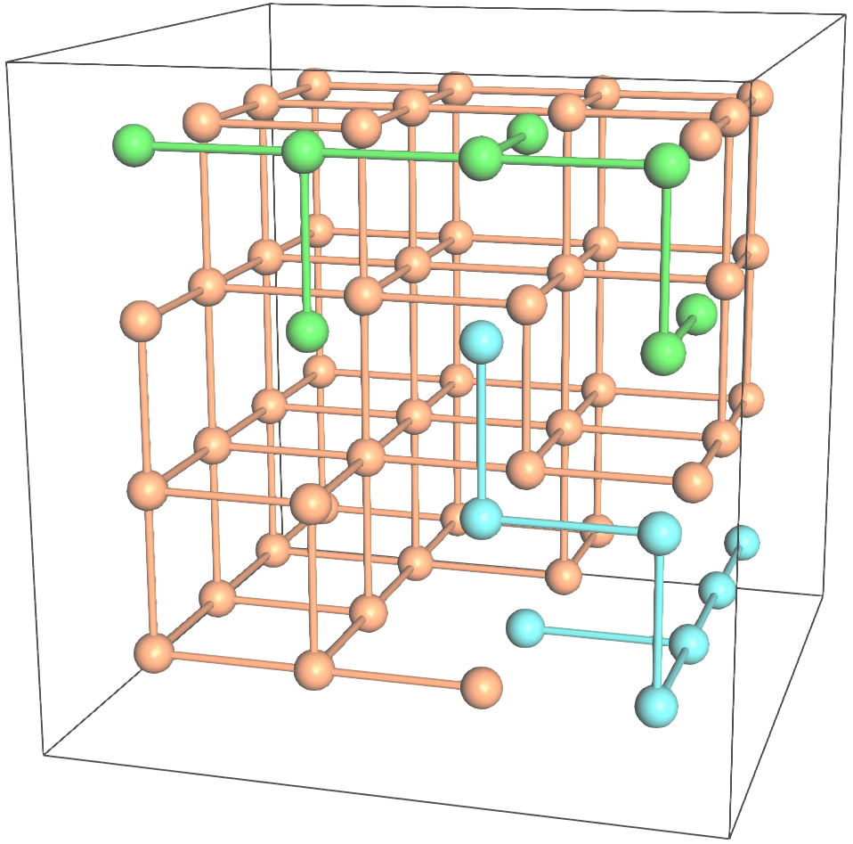
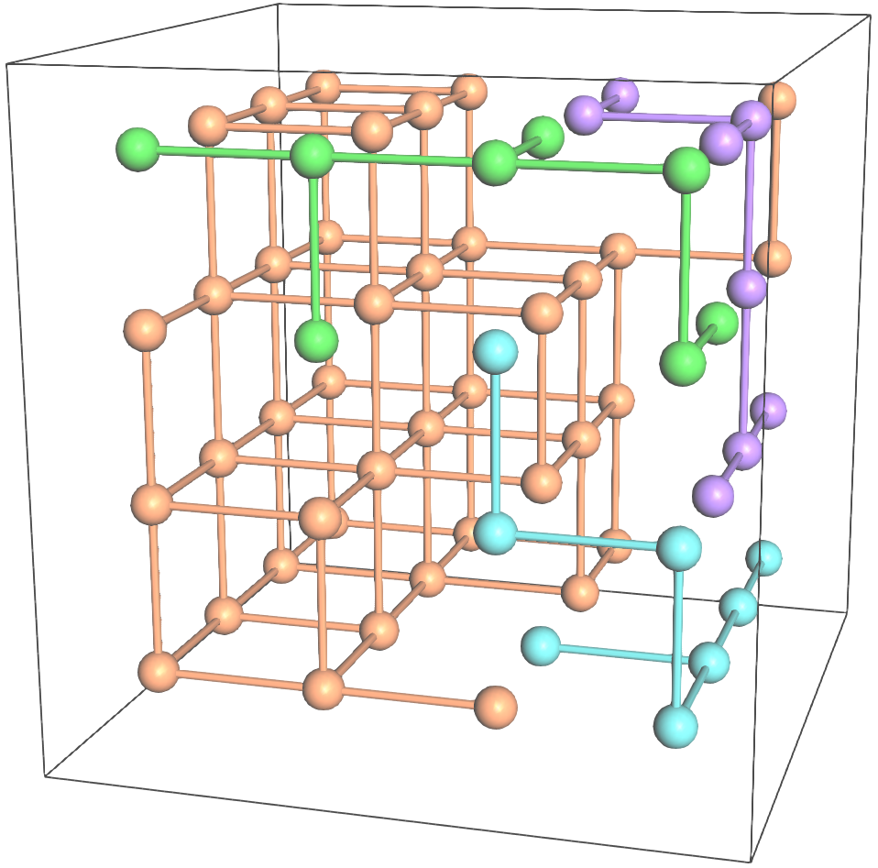
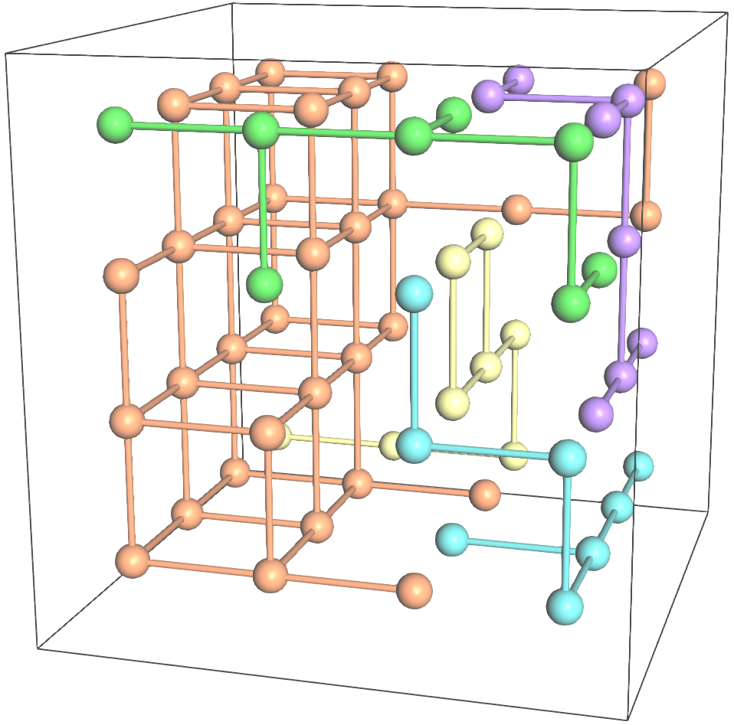
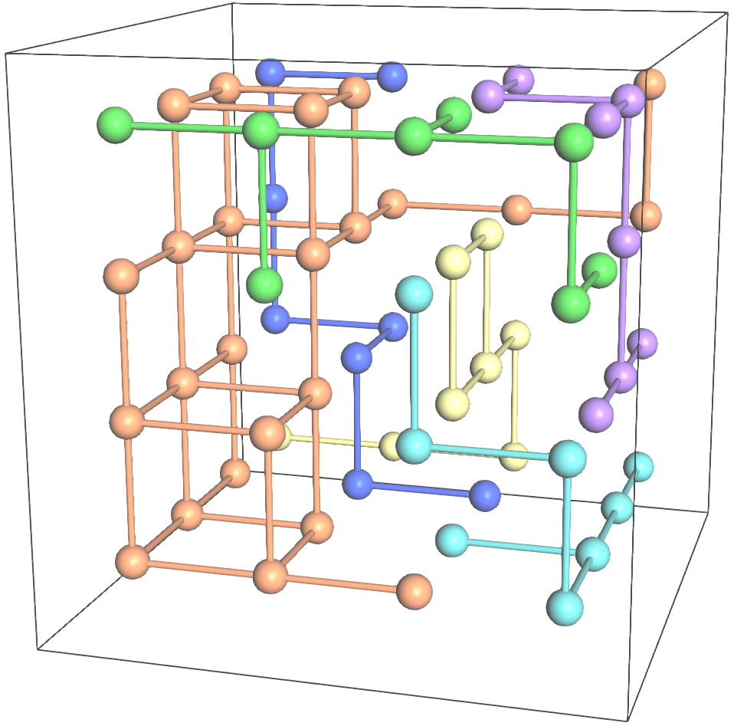
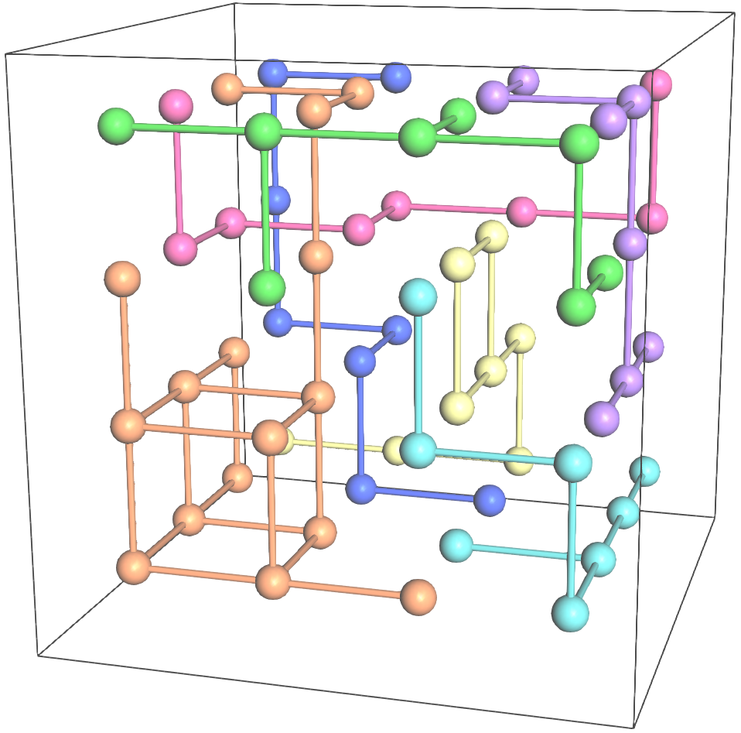
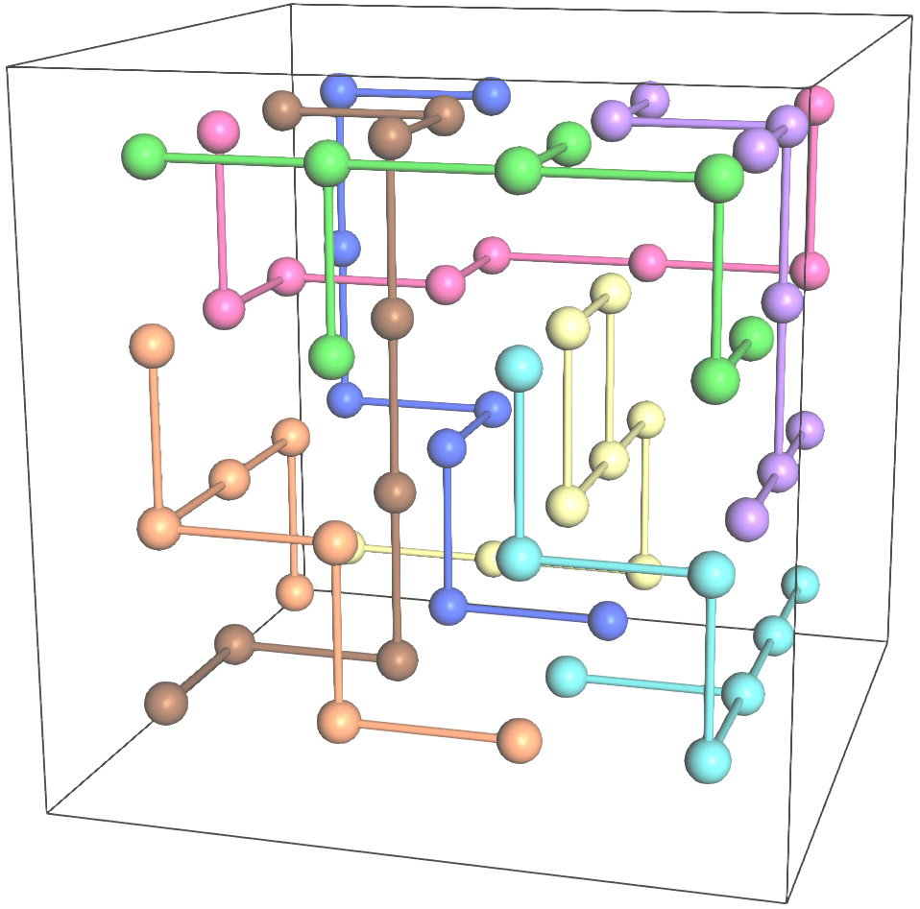
+y
+z
+x
1
1
1
1
1
1
1
DBGs
for
d = +x
2
2
3
2
3
2
3
2
3
2
3
2
3
4
4
5
4
5
4
5
4
5
6
6
7
6
8
7
DBGs
for
d = +y
2
1
2
1
3
2
1
3
2
1
3
2
1
3
2
1
3
2
1
3
4
4
5
4
5
4
5
4
5
6
6
7
6
8
7
DBGs
for
d = +z
2
1
2
1
3
2
1
3
2
1
3
2
1
3
2
1
3
2
1
3
4
4
5
4
5
4
5
4
5
Result of [Song et al. 2012]
6
6
7
6
8
7
(a)
(b)
(c)
(d)
(e)
(f)
(g)
+y
+z
+x
1
1
1
1
1
1
1
DBGs
for
d = +x
2
2
3
2
3
2
3
2
3
2
3
2
3
4
4
5
4
5
4
5
4
5
6
6
7
6
8
7
DBGs
for
d = +y
2
1
2
1
3
2
1
3
2
1
3
2
1
3
2
1
3
2
1
3
4
4
5
4
5
4
5
4
5
6
6
7
6
8
7
DBGs
for
d = +z
2
1
2
1
3
2
1
3
2
1
3
2
1
3
2
1
3
2
1
3
4
4
5
4
5
4
5
4
5
Result of our approach
6
6
7
6
8
7
(h)
(i)
(j)
(k)
(l)
(m)
(n)

Slide 3
+y
+z
+x
1
1
1
1
1
1
1
DBGs
for
d = +x
2
2
3
2
3
2
3
2
3
2
3
2
3
4
4
5
4
5
4
5
4
5
6
6
7
6
8
7
DBGs
for
d = +y
2
1
2
1
3
2
1
3
2
1
3
2
1
3
2
1
3
2
1
3
4
4
5
4
5
4
5
4
5
6
6
7
6
8
7
DBGs
for
d = +z
2
1
2
1
3
2
1
3
2
1
3
2
1
3
2
1
3
2
1
3
4
4
5
4
5
4
5
4
5
Result of [Song et al. 2012]
6
6
7
6
8
7
(a)
(b)
(c)
(d)
(e)
(f)
(g)
+y
+z
+x
1
1
1
1
1
1
1
DBGs
for
d = +x
2
2
3
2
3
2
3
2
3
2
3
2
3
4
4
5
4
5
4
5
4
5
6
6
7
6
8
7
DBGs
for
d = +y
2
1
2
1
3
2
1
3
2
1
3
2
1
3
2
1
3
2
1
3
4
4
5
4
5
4
5
4
5
6
6
7
6
8
7
DBGs
for
d = +z
2
1
2
1
3
2
1
3
2
1
3
2
1
3
2
1
3
2
1
3
4
4
5
4
5
4
5
4
5
Result of our approach
6
6
7
6
8
7
(h)
(i)
(j)
(k)
(l)
(m)
(n)

Slide 4
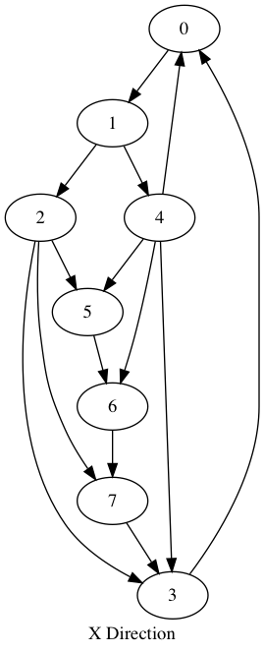
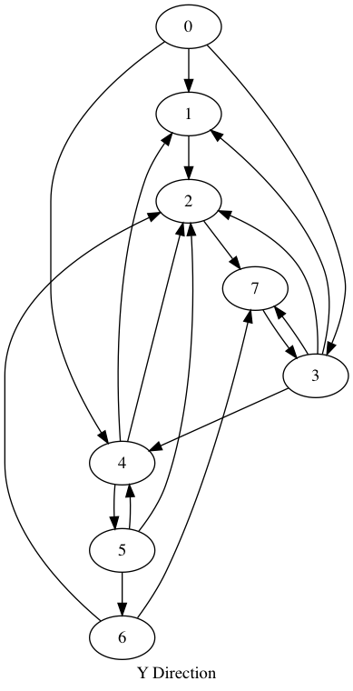
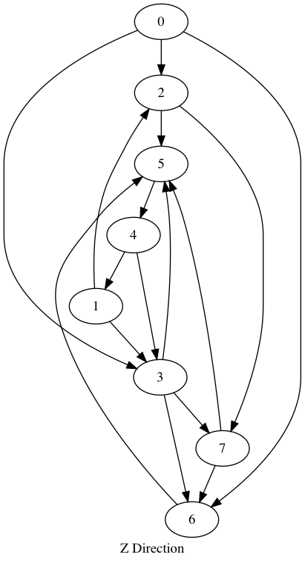
1
1
1
2
1
2
3
1
3
5
2
3
3
2
1
3
6
2
3
6
8
5
4
5
4
5
4
4
5
2
6
7
7
6
7
5
6
7
4
8
8
8
6
8
8
4
7
7

Slide 5
1
2
1
3
2
3
2
1
3
4
5
4
5
6
7
4
5
6
7
8
6
7
8
8

